Slide 1
Tkinter
A python GUI Library

Slide 2
What is Tkinter?
Tkinter is a Python library for creating Graphical User Interfaces (GUI).
It is the standard GUI library that comes bundled with Python.
Tkinter is cross-platform, meaning it works on various operating systems like Windows, macOS, and Linux.
It provides a set of widgets (UI components) for building desktop applications.
These widgets include buttons, labels, text fields, checkboxes, radio buttons, and more.
Tkinter allows developers to create windows, frames, and dialogs to organize the GUI elements.

Slide 3
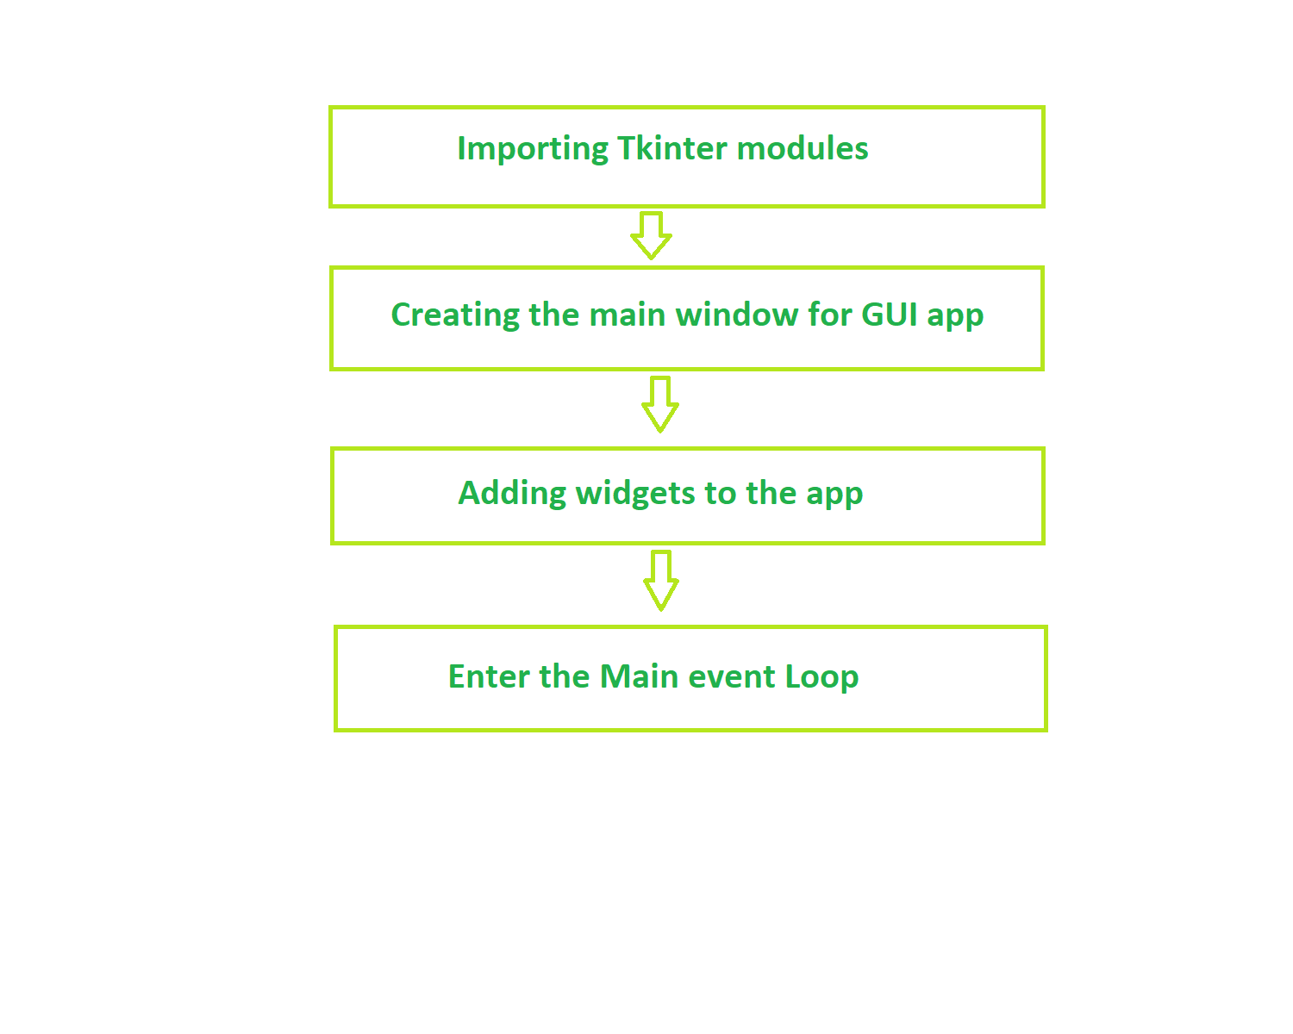
Fundamental structure of tkinter program

Slide 4
Widgets
In general, Widget is an element of Graphical User Interface (GUI) that displays/illustrates information or gives a way for the user to interact with the OS. In Tkinter , Widgets are objects ; instances of classes that represent buttons, frames, and so on.
Each separate widget is a Python object. When creating a widget, you must pass its parent as a parameter to the widget creation function. The only exception is the “root” window, which is the top-level window that will contain everything else and it does not have a parent.

Slide 5
Widget Classes
Label
It is used to display text or image on the screen
Button
It is used to add buttons to your application
Canvas
It is used to draw pictures and others layouts like texts, graphics etc.
ComboBox
It contains a down arrow to select from list of available options
CheckButton
It displays a number of options to the user as toggle buttons from which user can select any number of options.
Radio Button
It is used to implement one-of-many selection as it allows only one option to be selected
Entry
It is used to input single line text entry from user

Slide 6
Frame
It is used as container to hold and organize the widgets
Message
It works same as that of label and refers to multi-line and non-editable text
Scale
It is used to provide a graphical slider which allows to select any value from that scale
Scrollbar
It is used to scroll down the contents. It provides a slide controller.
SpinBox
It is allows user to select from given set of values
Text
It allows user to edit multiline text and format the way it has to be displayed
Menu
It is used to create all kinds of menu used by an application

Slide 7
Geometry Management
Geometry management in Tkinter refers to the way you arrange and position widgets (user interface elements like buttons, labels, and entry fields) within the window or frame of your graphical application. It determines how widgets are organized and displayed on the screen.
Pack: It organizes widgets by stacking them either vertically or horizontally, allowing them to automatically adjust their size and placement.
Grid: This method arranges widgets in rows and columns, similar to a grid or table. You specify the row and column where each widget should be placed.
Place: It allows you to specify the exact coordinates (x and y) where a widget should be positioned within the window or frame. This method provides more precise control over widget placement.

Slide 8
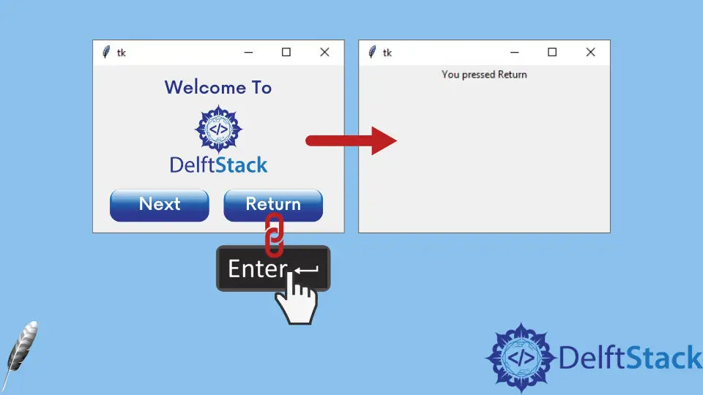
Binding Function
Binding functions in Tkinter is a way to associate a function or method with a particular event that occurs in a widget, such as a button click or a keypress. When that event happens, the associated function is executed. This allows you to make your Tkinter application interactive and responsive to user actions.

Slide 9
import tkinter as tk
def button_click(event):
print("Button clicked!")
root = tk.Tk()
button = tk.Button(root, text="Click Me")
button.pack()
button.bind("<Button-1>", button_click) # Bind the function to the left mouse button click event
root.mainloop()

Slide 10
Advantages and Disadvantages
Advantages of Tkinter:
Easy Learning
Cross-Platform
Standard Library
Disadvantages of Tkinter:
Limited Aesthetics
Fewer Widgets
Complex Layouts

